Slide 1
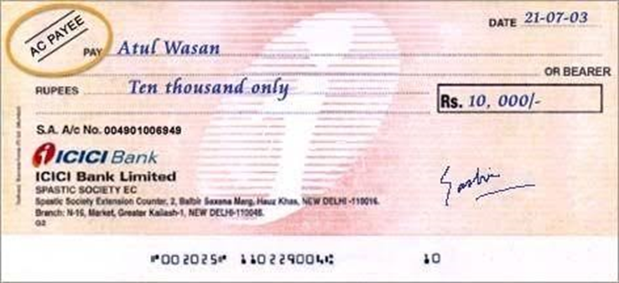
Crossing of a cheque

Slide 2
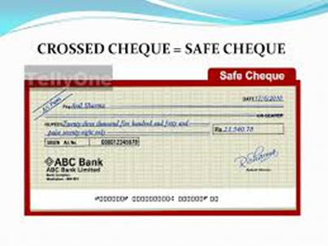
Meaning
Crossing prevents fraud and wrong payments. It means “Drawing Two Parallel Lines” across the face of the cheque. Thus crossing is necessary in order to have safety.

Slide 3
Who can Cross a Cheque?
Drawer – a drawer will cross the cheque either generally or specially.
Holder – a cheque is given to the holder by the drawer without crossing, the holder can cross the cheque.
Holder in due course – a holder in due course can also cross the cheque provided the cheque is not crossed or crossed generally.
Banker – a banker can cross a cheque when he receives it for collection.

Slide 4
Two types of Crossing
General Crossing
Special Crossing

Slide 5
General Crossing
According to Section 123, “where a cheque bears across its face an addition of the words ‘And Company’ or any abbreviation thereof, between two parallel transverse lines, or two parallel transverse lines simply either with or without the words “Not negotiable” that addition shall be deemed a crossing, and the cheque shall be deemed to be crossed generally”.

Slide 6
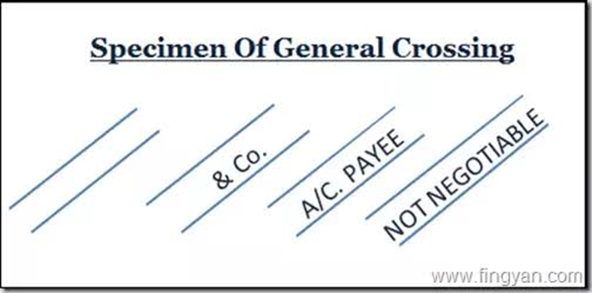

Slide 7
Two types of words in General Crossing
Not Negotiable crossing – Clear indication to the banker that the bank has to be very careful while making payments on the cheque.
Account Payee crossing – when a cheque is crossed “account payee only”, payment should be credited by the bank only to the account of the payee.

Slide 8
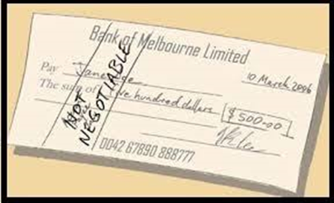
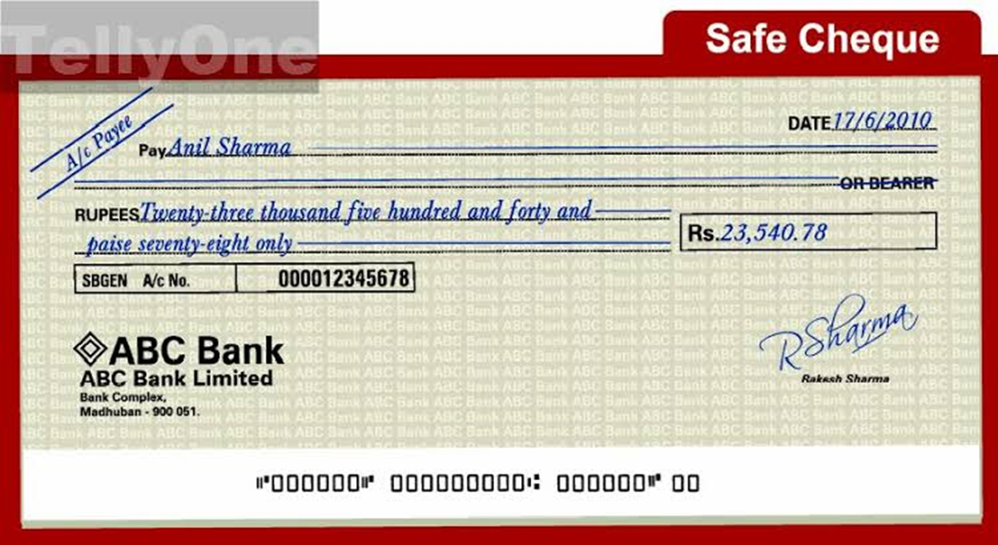

Slide 9
Special Crossing
According to Section 124, “where a cheque bears across its face an addition of the name of the banker, either with or without the words “Not negotiable” that addition shall be deemed a crossing, and the cheque shall be deemed to be crossed specially and to be crossed to that banker”.

Slide 10
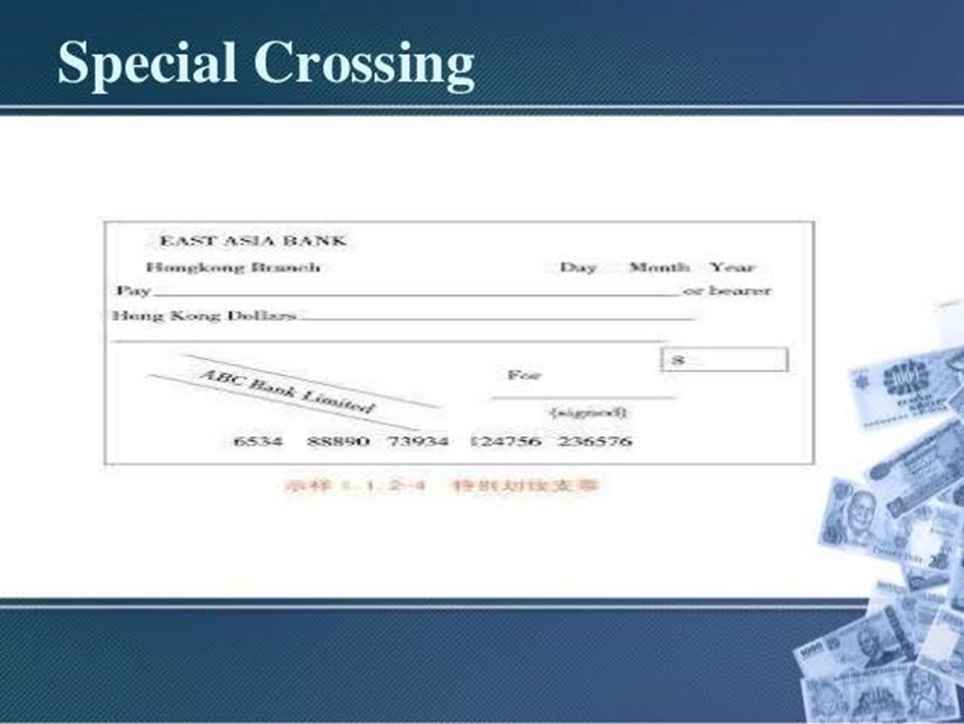

Slide 11
Type of Special crossing
Double special crossing or Double crossing - Sometimes the bank whose name is appearing in the crossing may not find a branch in the place where the payee is to present the cheque, bank has to appoint another bank as its agent for collection.

